Slide 1
Automated Plant Watering System
Keep your plants Alive
Group 35

Slide 2
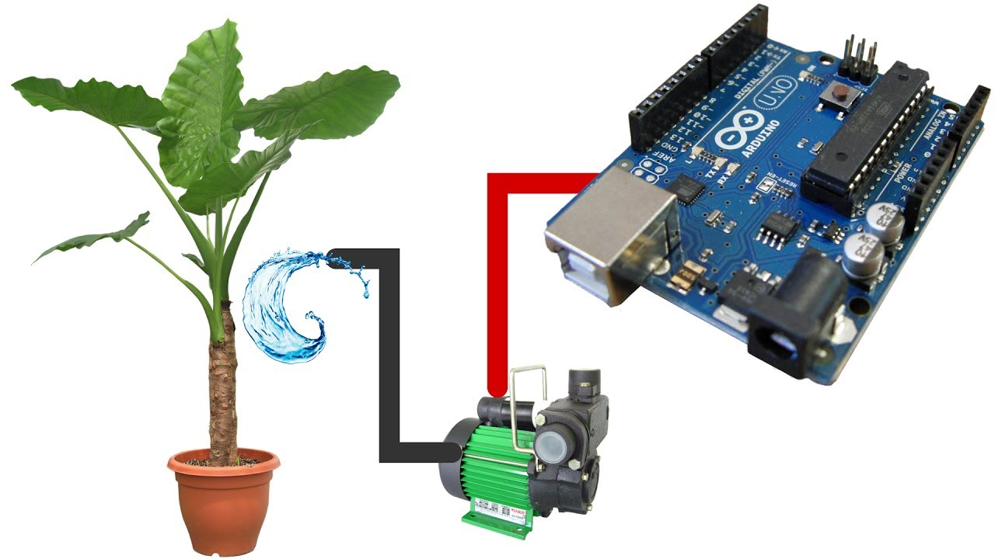
Introduction

Slide 3
What is it?
Basically this is a soil moisture monitoring system, which detects moisture content in the soil .
If it goes below a certain critical point, it is time to water the plant until the soil surrounding the plant is moist enough.
An arrangement of a DC motor and a servo motor is used to control the watering mechanism

Slide 4
Hardware Used
Arduino Uno
Soil moisture sensor module
Motor driver IC L293D
Servo motor
Pump motor
12V DC adapter
Wires and jumper cords.

Slide 5
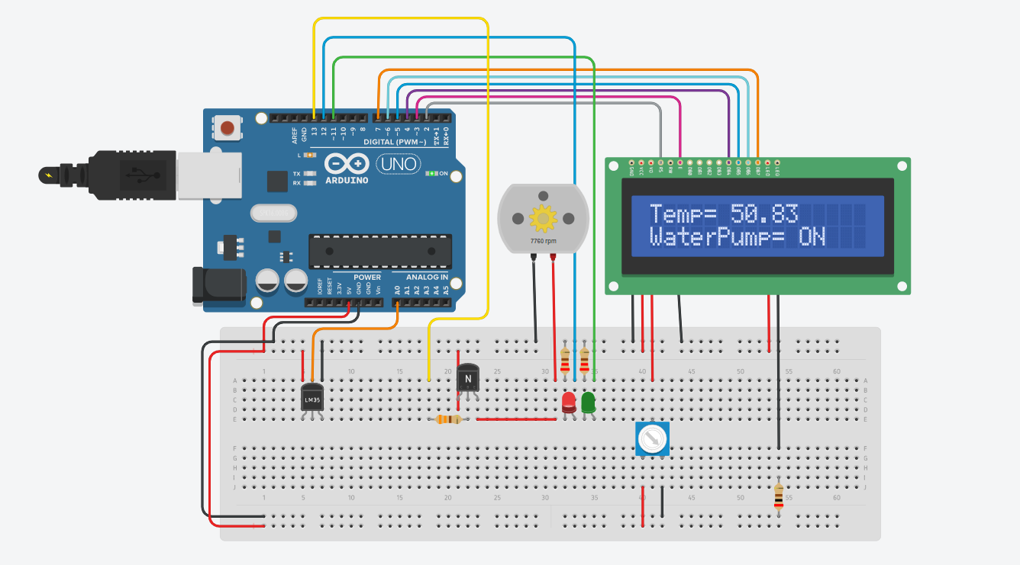
HARDWARE IMPLEMENTATION

Slide 6
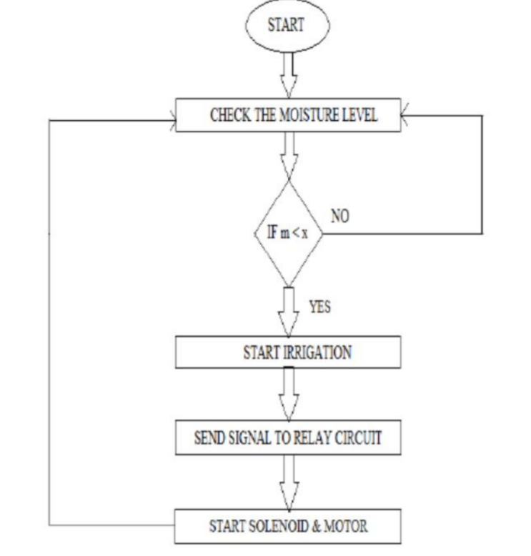
BLOCK DIAGRAM

Slide 7
Software Implementation

Slide 8
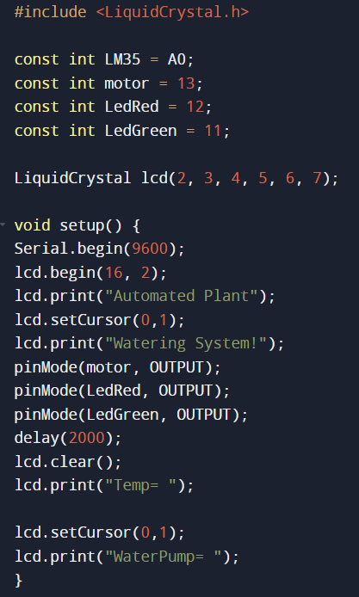
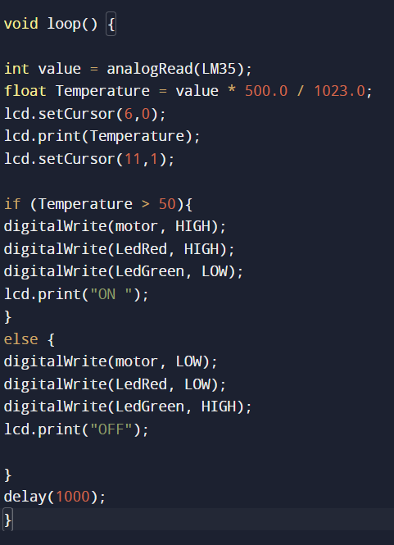

Slide 9
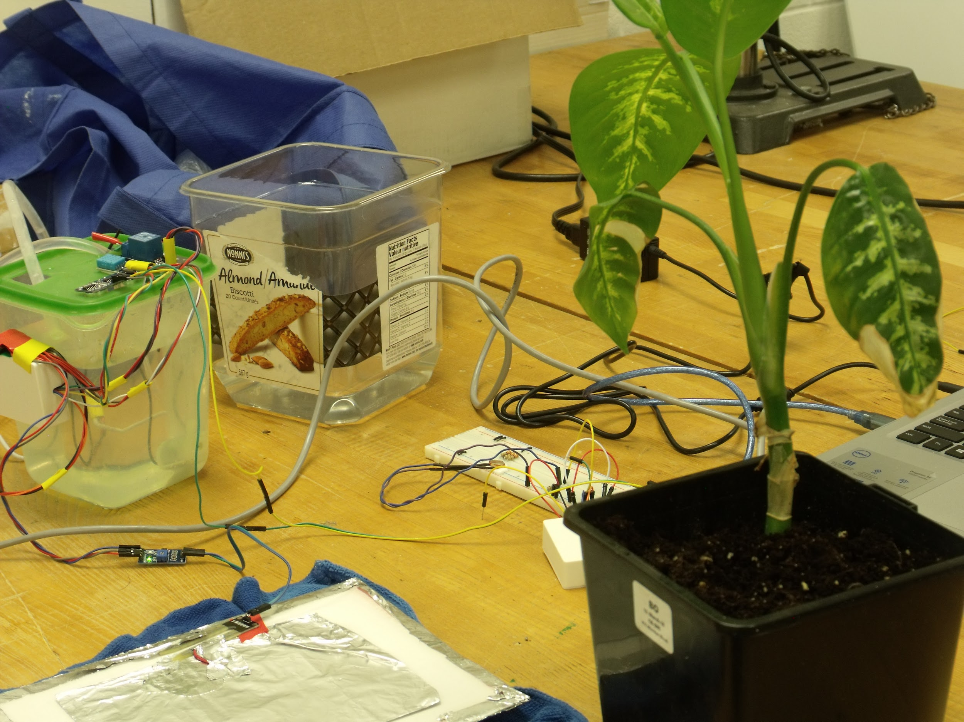
Automated Plant Watering System Using Arduino

Slide 10
Conclusion and Future Scope

